Slide 1

Multimodal Fusion in Transformer Neural Networks
By: Alan Devkota
Advisor: Dr. Xin Fu
ECE 6011_23545
Sept 29, 2023
Department of ECE, University of Houston
Houston, TX, USA

Slide 2
Outline
Overview of Multimodality.
Overview of Transformer Neural Networks.
Attention Mechanism in Transformers.
From Self-Attention to Cross-Attention
Background of Vision Transformer
Examples of Cross-modal Interactions
Applications of Multi-modal Transformers
Extension to higher Modalities
Conclusion

Slide 3
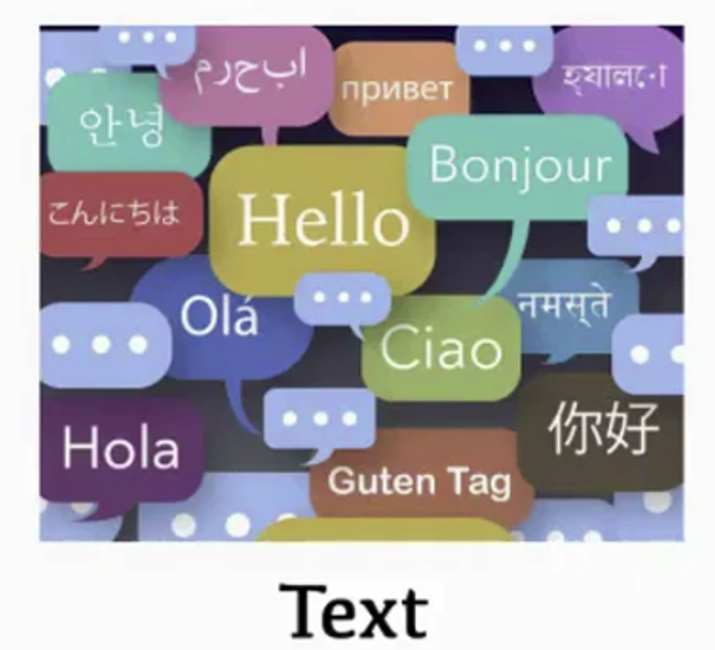
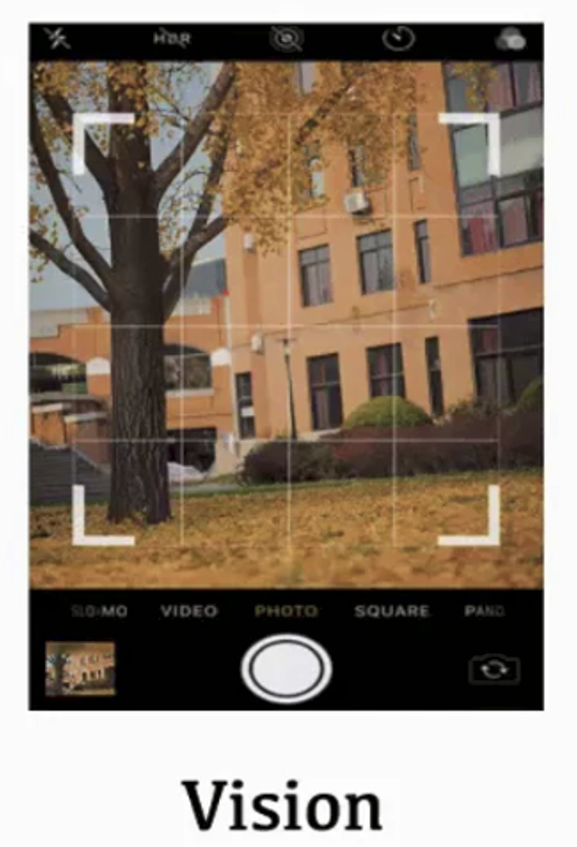

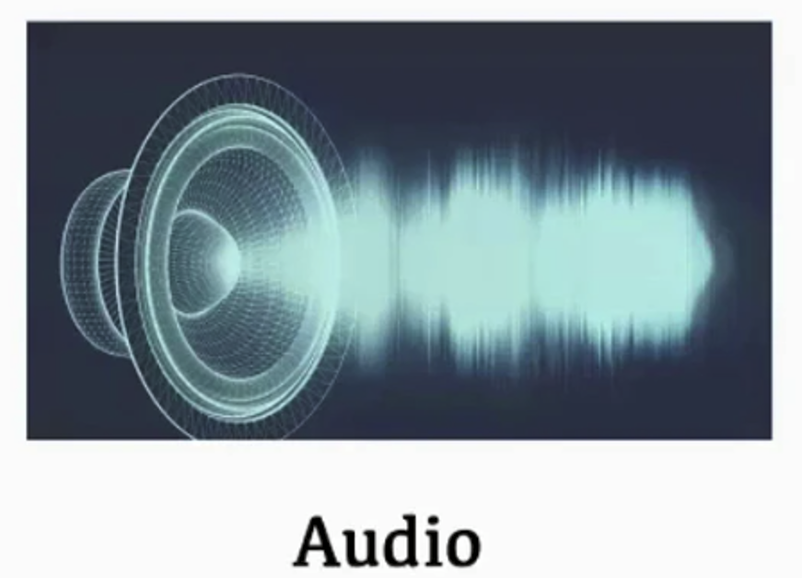
Motivation: Our experience of the world is multimodal
Humans perceive the world through multiple modalities, enabling a holistic understanding of their environment.
Modality refers to the way in which information is captured or experienced.
Modalities can include various sensory inputs like audio, vision (images and videos), text, and even less common ones like odors or touch.
Multimodal fusion involves integrating information from different modalities to create a unified representation.
For AI to match human intelligence, it's imperative that it learns to interpret, reason, and fuse multimodal information.

Slide 4
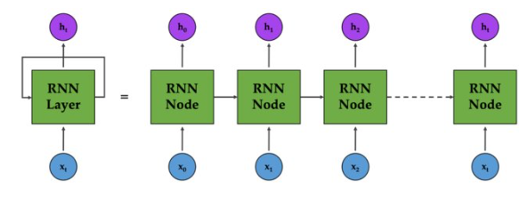
Overview of Transformer Neural Networks
From RNNs to Transformers
RNN = Recurrent Neural Network
Widely used in Natural Language Processing (until 2017)
Processing text sequentially, token by token.
Notes:
RNN takes a word processes it and outputs a hidden state h0.
Next step is for next word x1 and we get the hidden state h0 we had from 1st step. We get next hidden state h1.
We repeat this until we have processed the entire sequence.

Slide 5
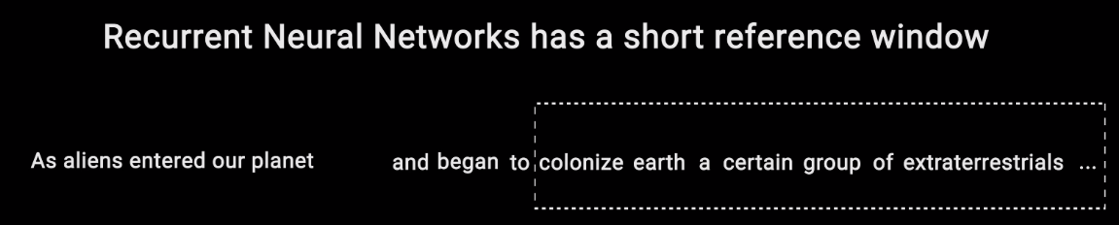
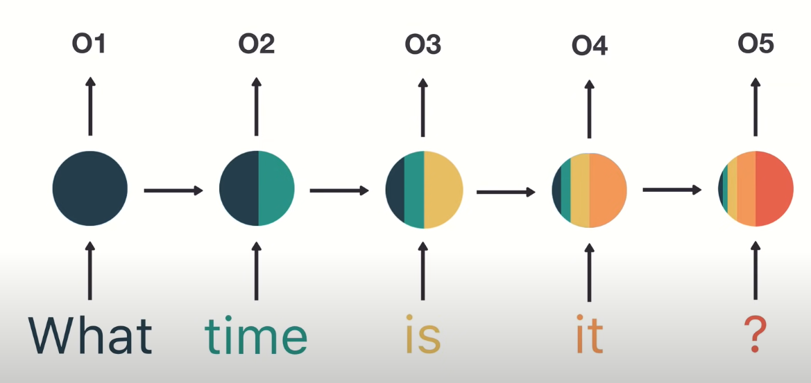
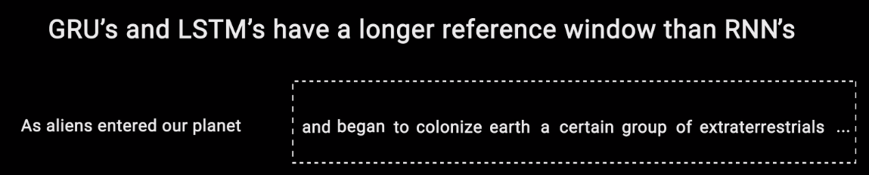
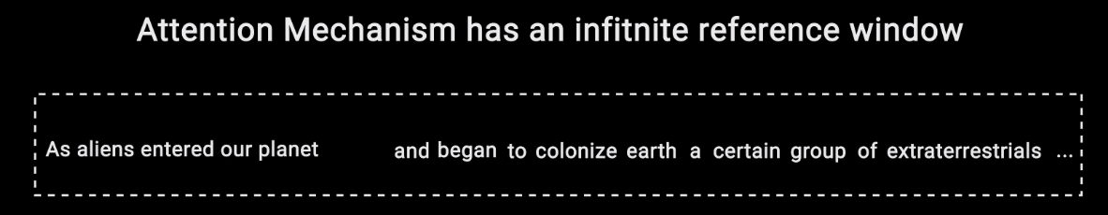
Overview of Transformer Neural Networks
From RNNs to Transformers
Why transformers?
RNN sequential processing – time consuming → Transformer – parallelization
RNN fail to obtain global information/ context → Transformers attend to every tokens (Because x0 is very far from xn)
RNN – single direction from left to right → Transformer both direction
Reference window is larger in Transformers.

Slide 6
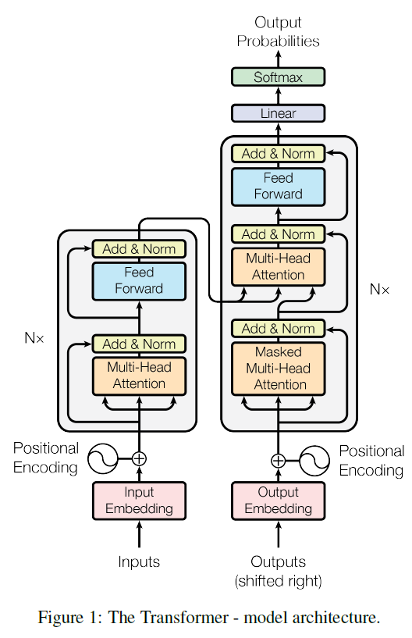
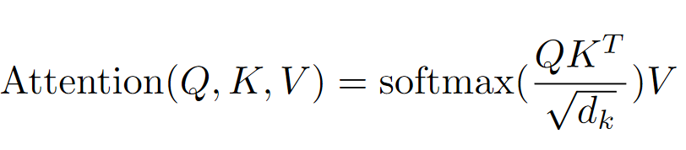
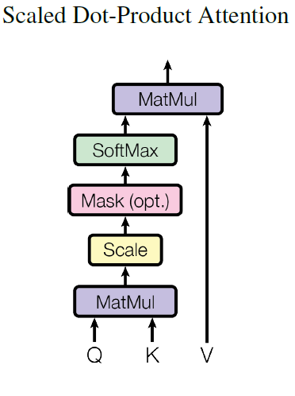
A Transformer is Born
Architecture of Transformer Neural Network
Cross-Attention
Self-Attention
Self-Attention

Slide 7

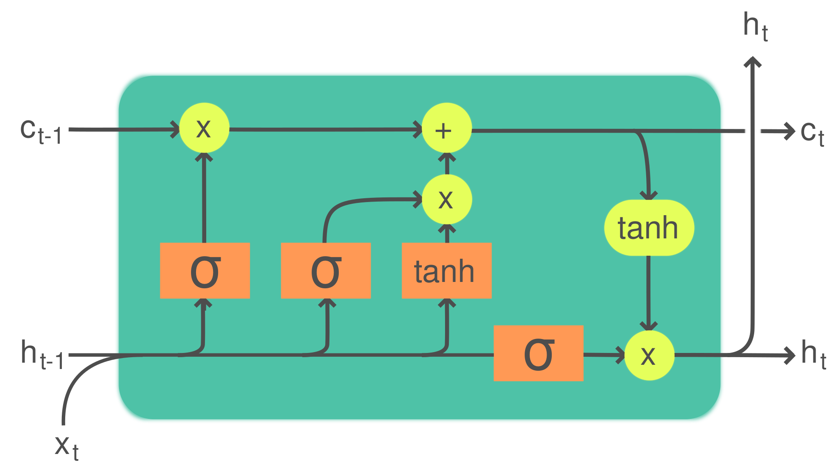
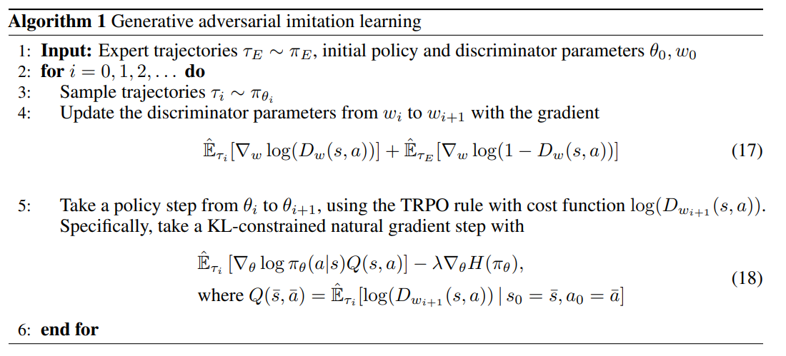
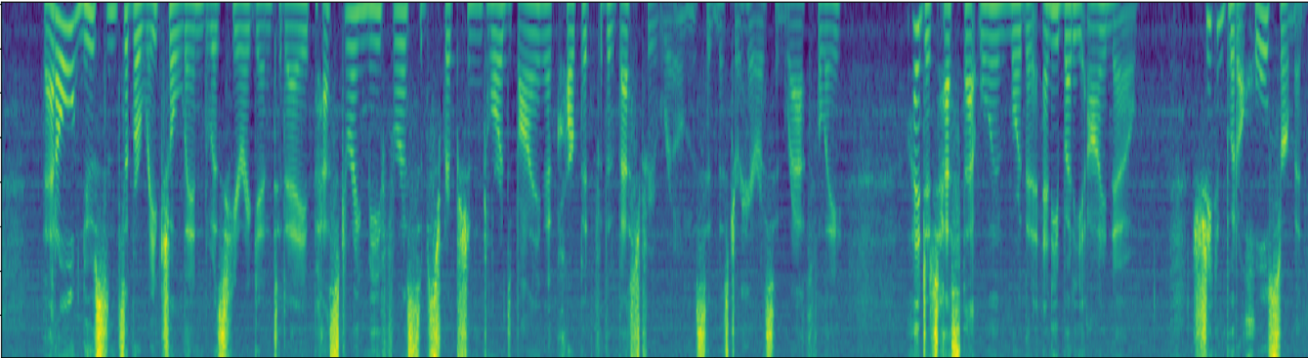
A Transformer is Born
Computer Vision
Convolutional NNs (+ResNets)
Natural Lang. Proc.
Recurrent NNs (+LSTMs)
[2]
h e l l o
[1]
Speech
Deep Belief Nets (+non-DL)
Translation
Seq2Seq
RL
BC/GAIL
s a l u t </s>
RBM
DBN
RBM
🔒
DBN
h e l l o </s> s a l u t
GRBM
🔒
DBN
[1] CNN image CC-BY-SA by Aphex34 for Wikipedia https://commons.wikimedia.org/wiki/File:Typical_cnn.png
[2] RNN image CC-BY-SA by GChe for Wikipedia https://commons.wikimedia.org/wiki/File:The_LSTM_Cell.svg
They all are single modality
Notes:
Before Transformers, Computer Vision had CNNs, Natural Language Processing had RNNs (+LSTMs), Likewise, Speech, Translation, and RL, they all had their own architecture.

Slide 8
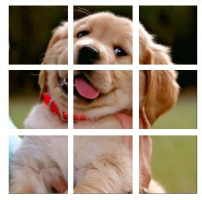
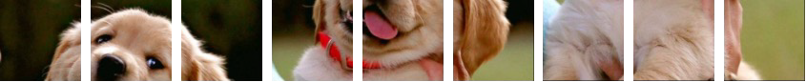

A Transformer is Born
The Transformer’s Takeover
Input Tokens
Computer Vision
Natural Lang. Proc.
Reinf. Learning
Speech
Biomedical
Graphs/Science
Notes:
And note that: because transformers are applicable to all domains it facilitates multimodality better than previous neural networks.

Slide 9
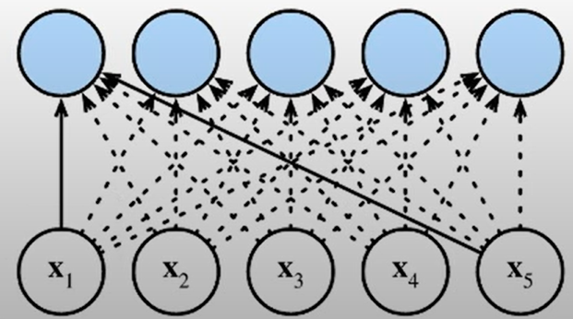
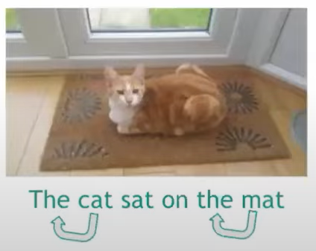
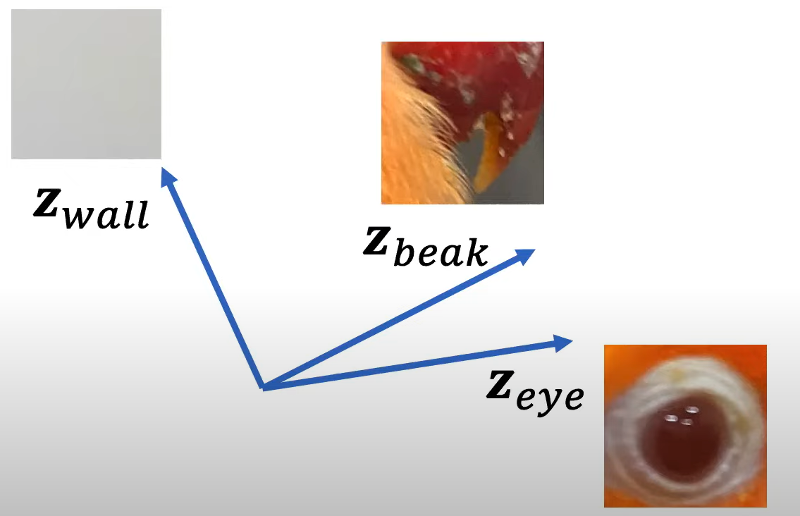
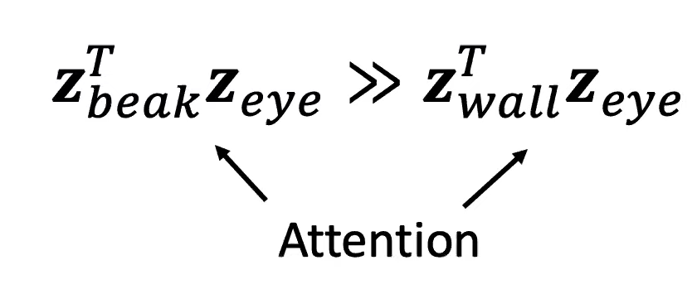
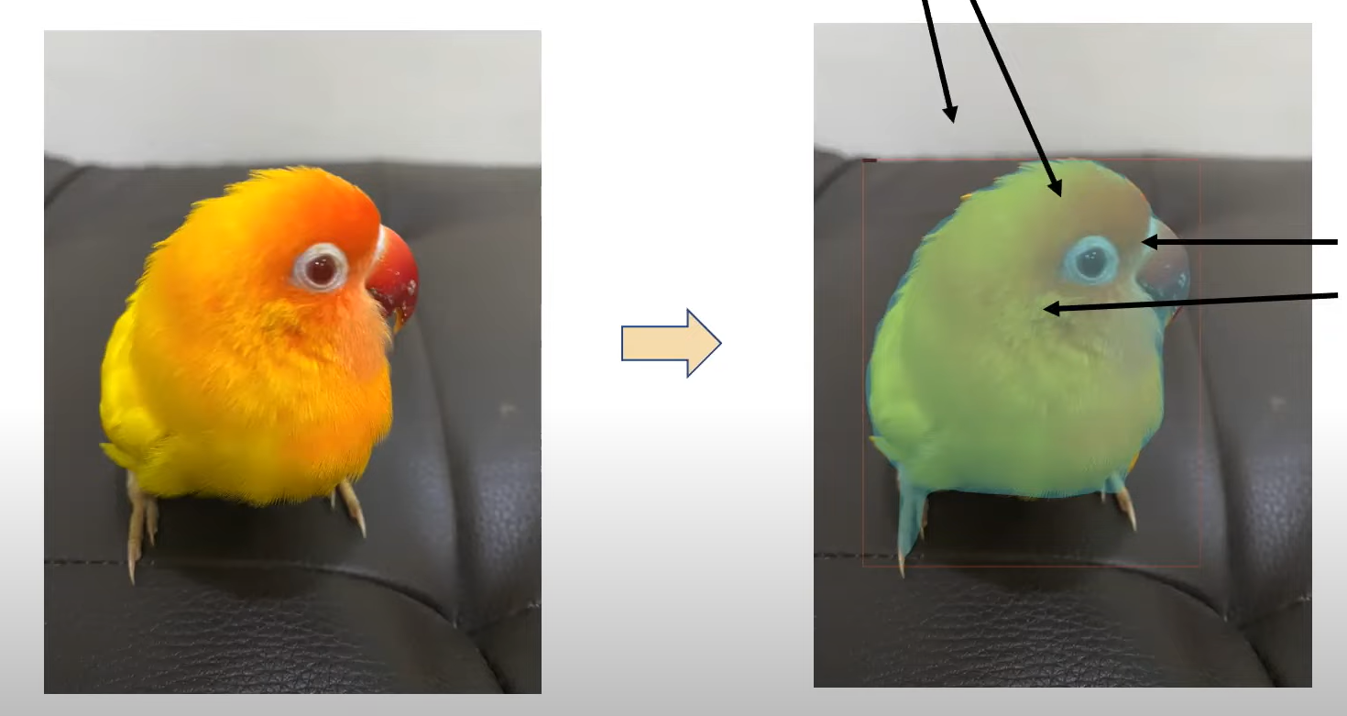
Attention
At the heart of the Transformer lies the simple attention mechanism.
Goal of attention mechanism is to take each words (tokens) as shown in figure and create a representation that that contains information from the other relevant parts (other words/ tokens). (Creates a contextualized representation for each input token)
In natural language processing:
The quick brown fox jumps over the lazy dog
Think of Dot product!!
Low Attention
High Attention
Notes:
What is contextualization?
We treat q,k,v (generated tokens) as some vector or say weight representing a numerical value and perform dot product.

Slide 10
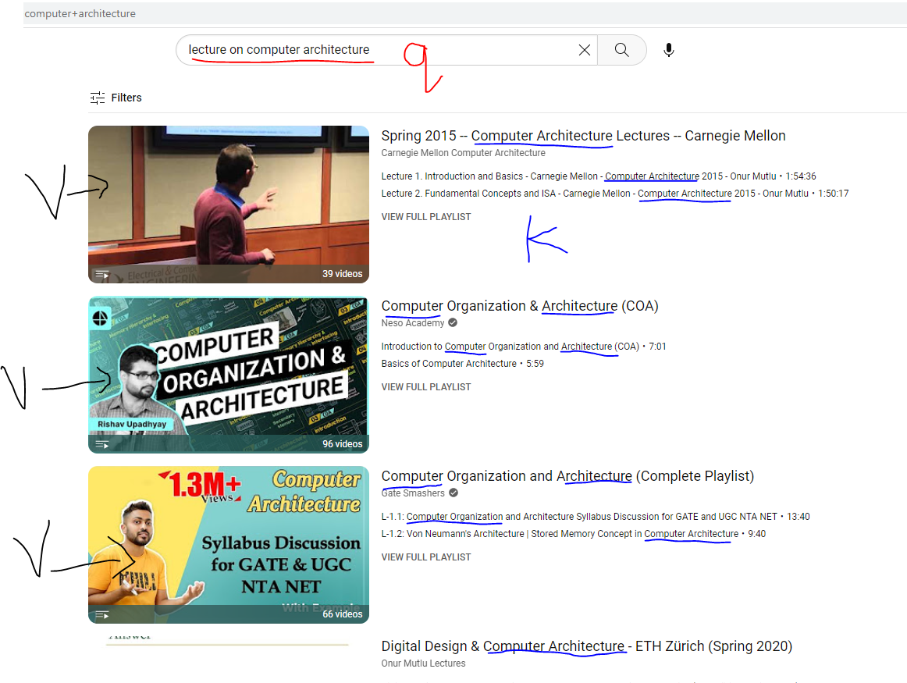
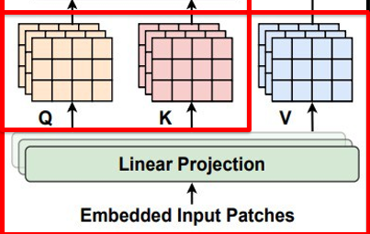
Attention - Intuition
Similar to retrieval from databases:
Query = a query we wish to run on a database
Key = the keys to search on in the database
Value = values corresponding to each key in the database
Intuition – each token “searches the database” for tokens related to it.
QUERY → Q
VALUE → V
KEY → K

Slide 11
From Self-Attention to Cross-Attention
Cross-attention is used to gain context from another modality/ input type
For example – gain context from text for image processing
Simply extract the queries, keys matrix from the other modality
From Text
From Image
From Text
Self-Attention
Cross-Attention

Slide 12
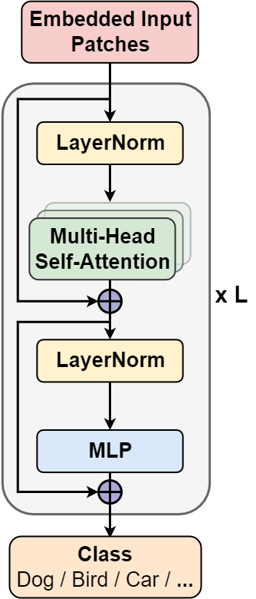
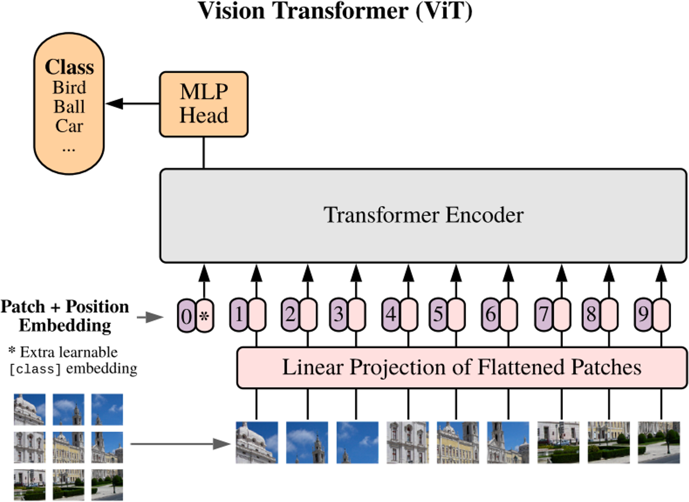

Background of Vision Transformer (ViTs)
Input: 2D image ➔ input tokens/patches
≈
Input Tokens
Core Model: Self-Attention and MLP
ViT Models

Slide 13
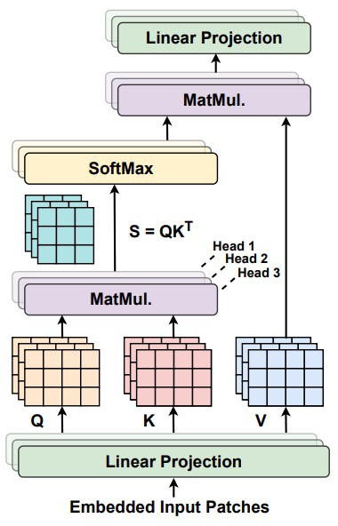



Background of Vision Transformer (ViTs)
QUERY → Q
VALUE → V
KEY → K

Slide 14
Examples of Cross-modal interactions
Audio-Text
Audio-Visual
Vision-Language
Video-Audio-Text

Slide 15
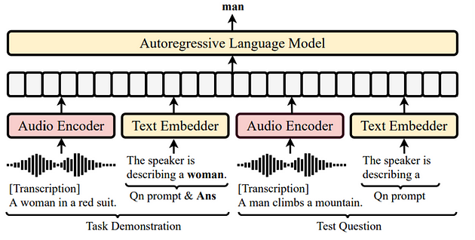
Audio-Text
Using the audio-text pair to learn spoken language understanding.
In this work, the audio embeddings and text embeddings are concatenated and fed into an autoregressive language model.
The audio encoder used is wav2vec 2.0 and the language model is GPT-2.
WAVPROMPT model architecture. [2]

Slide 16
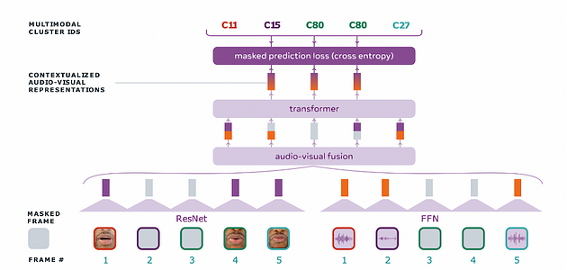
Audio-Visual
Automatic speech recognition combined with lip reading.
Lip reading is utilized to aid in automatic speech recognition tasks.
Audio-Visual Hidden Unit BERT (AV-HuBERT). [3]

Slide 17
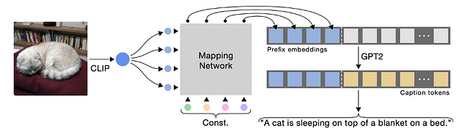
Vision-Language
Generate corresponding captions conditioned on the given image.
Features of images are extracted by CLIP encoder since CLIP is designed to impose a shared representation for both images and text prompts.
Then, a mapping network is applied to produce prefix embeddings which are then combined with the caption embeddings.
These are then fed to the language model.
ClipCap model architecture. [4]

Slide 18
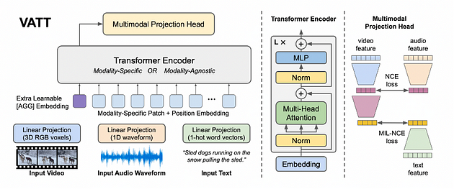
Video-Audio-Text
Zero-Shot Text-to-Video Retrieval: Given a particular text query and a pool of candidate videos, the task is to select the video that best corresponds to the text query.
Video Action Recognition: The task is to recognize common human actions in a video.
Audio Event Classification: The task is to recognize the respective audio events and their temporal start and end times in a recording.
VATT model architecture. [5]
Notes:
We define a semantically hierarchical common space to account for the granularity of different modalities and employ the Noise Contrastive Estimation (NCE) to train the model.

Slide 19
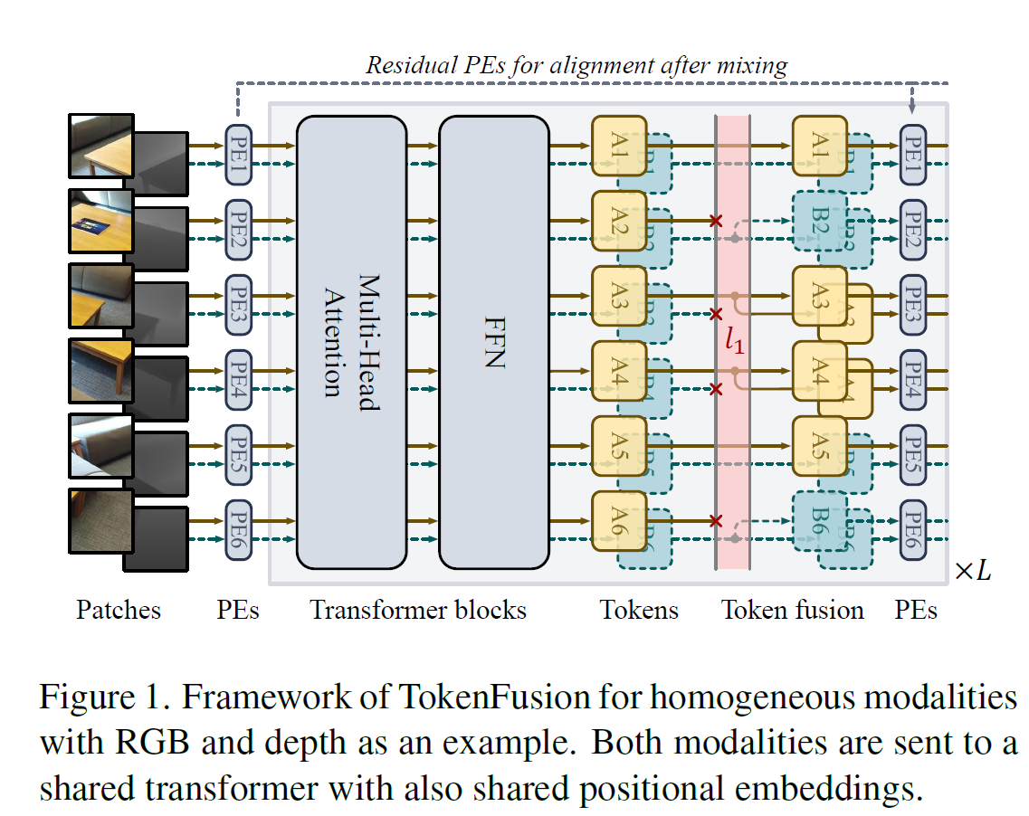
Higher Modalities: Multimodal Token Fusion for Vision Transformers
Proposes TokenFusion for fusing multiple vision transformer models handling different modalities (e.g., images, point clouds).
Dynamically detects and prunes uninformative tokens from each transformer. The pruned tokens are substituted with projected features from other modalities.
This allows combining off-the-shelf transformers without much modification to their original designs.
Model architecture. [10]

Slide 20
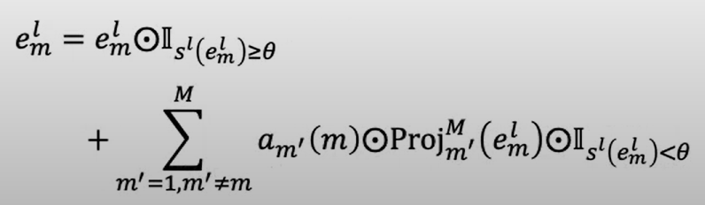
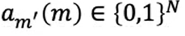
Homogeneous Multimodal Fusion
Homogeneous modalities refer to multiple sources of data that are of the same type, such as multiple images or multiple audio files.
Both RGB and depth data are sent to a shared transformer. Overall, this framework allows the model to learn correlations between the RGB and depth data.
A pre-allocation is carried out so the fusion process can be of following form.
Pre-allocation

Slide 21
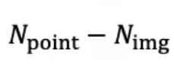
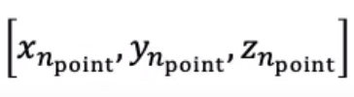
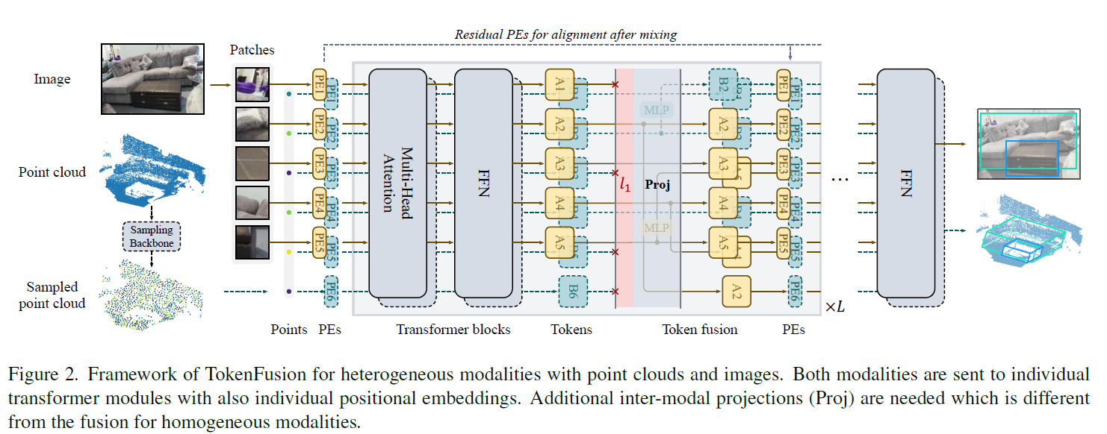
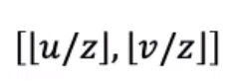
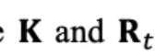
Heterogeneous Fusion for Vision Transformers (e.g., 3D object detection based on point cloud and 2D image
Additional inter-modal projections (Proj) are needed.
Image and 3d point data are mapped to the n-th image patch.
The TokenFusion method dynamically detects uninformative tokens and substitutes them with projected and aggregated inter-modal features.
3-d point data
2D pixel data
Camera parameters
Notes:
W and P are image width and patch width resp.

Slide 22
Some other Applications
Multi-Modal Retrieval
Image Captioning
Image Question Answering

Slide 23
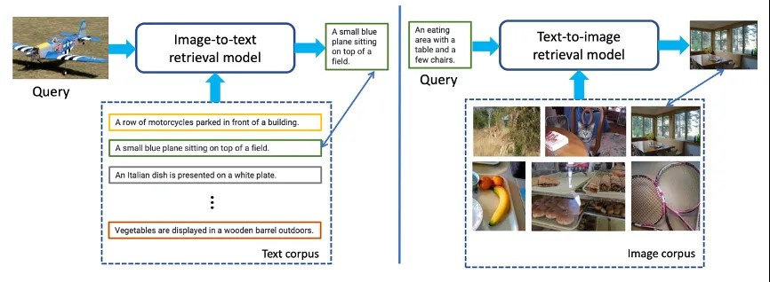
Multi-Modal Retrieval
This model has two capabilities: image-to-text retrieval and text-to-image retrieval.
The former provides text from an image query, while the latter provides an image from a text query.
Image-to-text and text-to-image retrieval. [7]

Slide 24
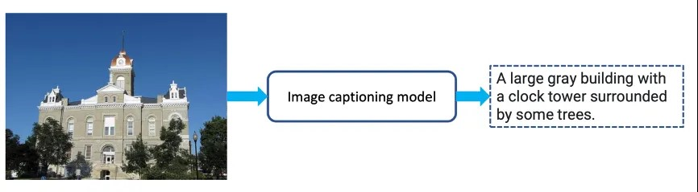
Image Captioning
The image captioning model generates a corresponding description based on a given image.
Example of image captioning. [7]

Slide 25
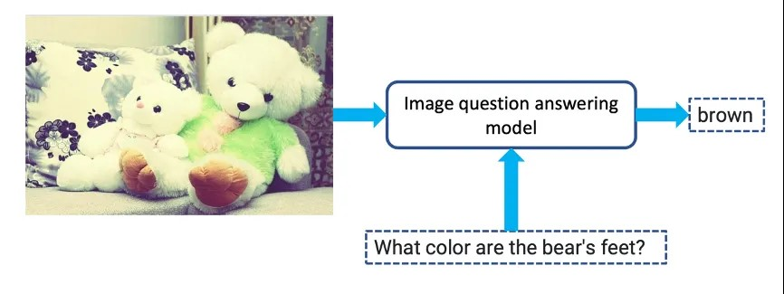
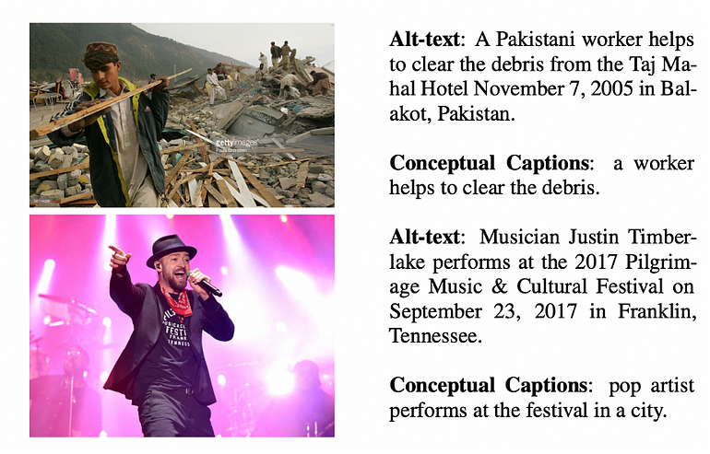
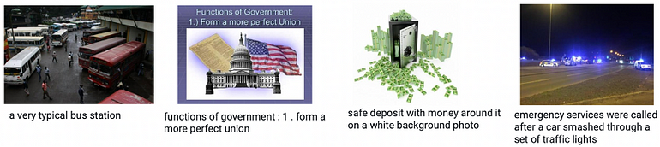
Image Question Answering
Image question answering is like image captioning. The model answers a question based on the image.
The challenge is to help the model understand the relationship between image and text. This can be done with large datasets of image-text pairs.
Example of image question answering. [8]
Example of image-caption(text) pairs. [9]
Example of image-text pairs. [7]

Slide 26
Conclusion
Enhanced Information: Multimodal data provides richer information than unimodal data, offering AI models a broader context for decision-making.
Challenges: Training multimodal networks is complex due to issues like data alignment and modality fusion, presenting significant research challenges.
Performance Improvement: The integration of multiple modalities can potentially lead to improved predictive performance in AI models.
New Possibilities: Multimodal AI unlocks capabilities that were previously challenging for unimodal models, enabling more human-like understanding and problem-solving.
Active Research: Multimodal deep learning is a dynamic and evolving research area with applications spanning various domains.

Slide 27
References
Morency, L. P., Liang, P., & Zadeh, A. (2022). Multimodal Machine Learning | CVPR 2022 Tutorial.
Chen, Y., Chen, Y., & Cheng, K. (2022). WAVPROMPT: Towards Few-Shot Spoken Language Understanding with Frozen Language Models.
Gao, L., Wang, J., & Zhang, H. (2022). Learning Audio-Visual Speech Representation by Masked Multimodal Cluster Prediction.
Zhou, L., Liu, X., & Zhang, Z. (2021). ClipCap: CLIP Prefix for Image Captioning.
Sun, L., Jia, K., & Qi, J. (2021). VATT: Transformers for Multimodal Self-Supervised Learning from Raw Video, Audio and Text.
CVPR 2022 Tutorial on “Recent Advances in Vision-and-Language Pre-training”.
CVPR 2022 Tutorial on “Recent Advances in Vision-and-Language Pre-training” | Overview of Image-Text Pre-training Slides.
Lu, J., Yang, J., Batra, D., & Parikh, D. (2016). Making the V in VQA Matter: Elevating the Role of Image Understanding in Visual Question Answering.
Sharma, P., Ding, N., Goodman, S., & Soricut, R. (2018). Conceptual Captions: A Cleaned, Hypernymed, Image Alt-text Dataset For Automatic Image Captioning.
Wang, Yikai, et al. "Multimodal token fusion for vision transformers." Proceedings of the IEEE/CVF Conference on Computer Vision and Pattern Recognition. 2022.

Slide 28
Thank you for your attention!
Questions ??
adevkota2@uh.edu

Slide 29
Extras

Slide 30
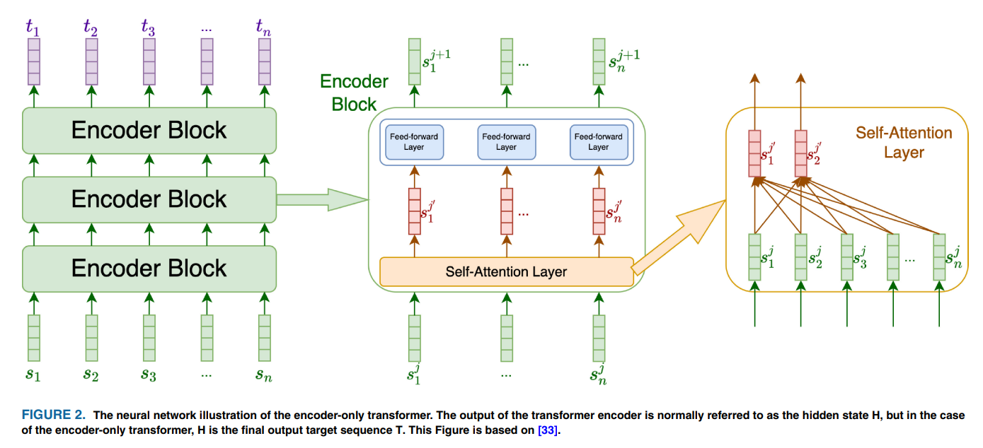
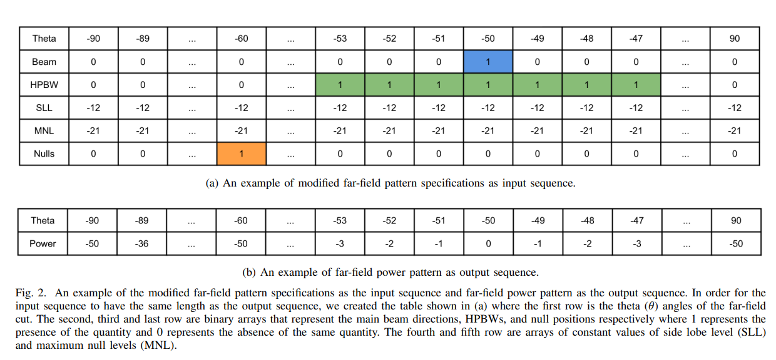
Some EM papers on Transformers
[1]
Notes:
The paper proposes a method to automatically generate far-field power patterns that meet desired performance criteria like beam directions, null locations, sidelobe levels, etc. This is useful as input for electromagnetic inversion algorithms that synthesize radiating structures.
Typically, the user provides the full desired power pattern, but it's more common to just have some performance specs. So, the goal is to convert those specs into a full power pattern.
It is using a neural network approach to automatically convert common antenna performance criteria into a full power pattern, which enables the use of inversion algorithms for radiating structure synthesis.

Slide 31
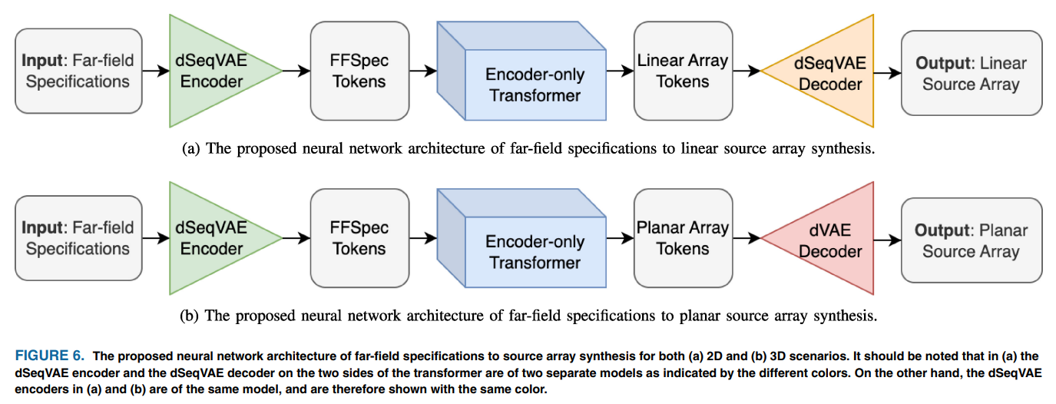
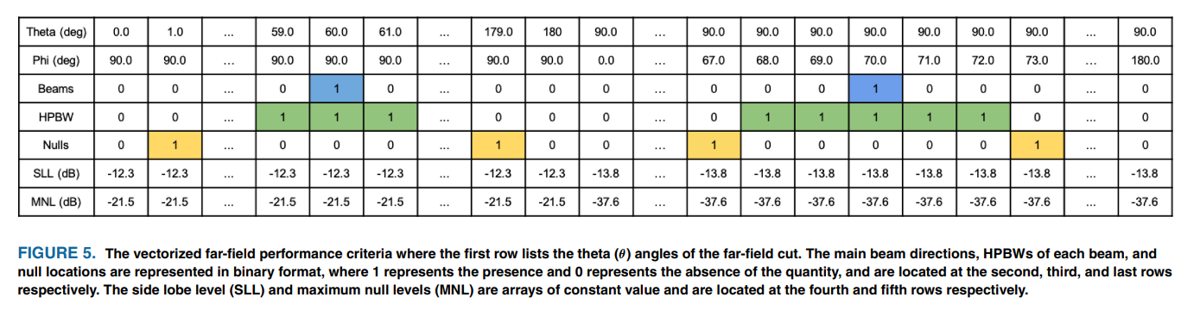
Some EM papers on Transformers
[2]
Notes:
Proposes a new deep learning based approach for metasurface design that goes directly from desired far-field specifications to required metasurface properties.
Develops a neural network architecture that takes far-field criteria as input and outputs equivalent source arrays to meet the specs.

Slide 32
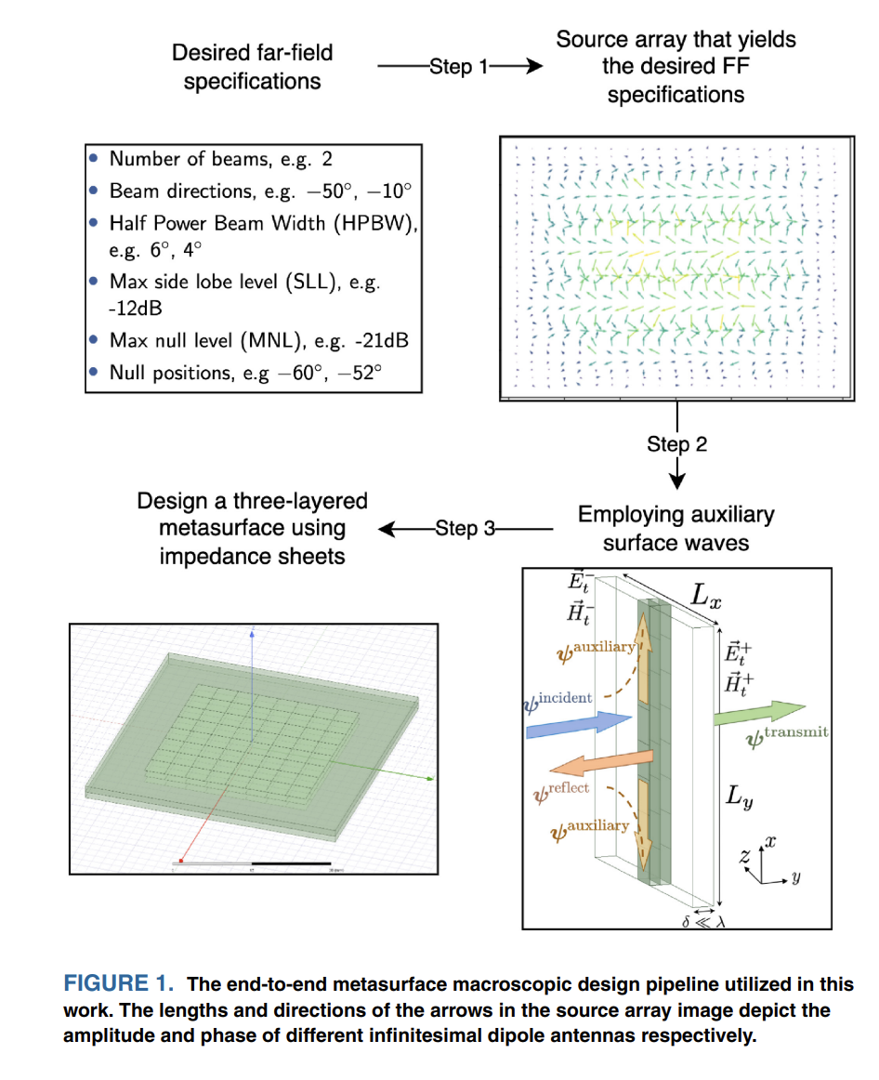
Some EM papers on Transformers
[2]
Notes:
Proposes a new deep learning based approach for metasurface design that goes directly from desired far-field specifications to required metasurface properties.
Develops a neural network architecture that takes far-field criteria as input and outputs equivalent source arrays to meet the specs.

Slide 33
Ref: Some EM papers on Transformers
Niu, Chen, et al. "A deep learning based approach to design metasurfaces from desired far-field specifications." IEEE Open Journal of Antennas and Propagation (2023).
Niu, Chen, Max Kelly, and Puyan Mojabi. "An encoder-only transformer to generate power patterns from far-field performance criteria." 2022 16th European Conference on Antennas and Propagation (EuCAP). IEEE, 2022.

Slide 34
How attention is calculated

Slide 35







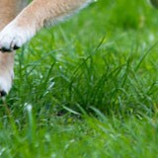

Vectorization
If the patches are 𝑑₁×𝑑₂×𝑑₃ tensors, then the vectors are 𝑑₁𝑑₂𝑑₃×1.
𝐱₁
𝐱₂
𝐱₃
𝐱₄
𝐱₅
𝐱₆
𝐱₇
𝐱₈
𝐱₉
Notes:
Vectorization: shaping tensor into vector

Slide 36
𝐳₁ = 𝐖 𝐱₁ + 𝐛
𝐳₂ = 𝐖 𝐱₂ + 𝐛
Also, add positional encoding vectors to 𝐳₁, 𝐳₂, ⋯ , 𝐳_{n}.
1
2
3
𝑛
Z’s are the result of linear transformation and positional encoding.
Positional Encoding:
⋯
𝐳₀
𝐳₁
𝐳₂
𝐳₃
⋯
𝐳_{n}
Embed
Dense
Dense
Dense
⋯
Dense
Share Parameters
[CLS]
𝐱₁
𝐱₂
𝐱₃
⋯
𝐱_{n}

Slide 37
Dense
Multi-Head Self-Attention Dense
Multi-Head Self-Attention
⋯
⋯
Transformer Encoder Network
𝐳₀
𝐳₁
𝐳₂
𝐳₃
⋯
𝐳_{n}
Embed
Dense
Dense
Dense
⋯
Dense
Share Parameters
[CLS]
𝐱₁
𝐱₂
𝐱₃
⋯
𝐱_{n}

Slide 38
Softmax Classifier
𝐩
𝐜
0
Transformer Encoder Network
𝐳₀
𝐳₁
𝐳₂
𝐳₃
⋯
𝐳_{n}
Embed
Dense
Dense
Dense
⋯
Dense
Share Parameters
[CLS]
𝐱₁
𝐱₂
𝐱₃
⋯
𝐱_{n}

Slide 39
Softmax Classifier
𝐩
𝐜
0
Confidence
0.4
0.2
0.12
0.07
0.06
0.05
0.04
0.06
Classes
bird
car cat dog fox jet snake
tiger

Slide 40
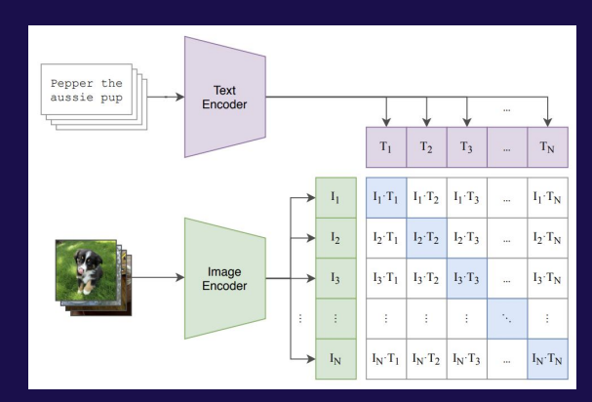
CLIP encoder

